Slide 1
CW
by
Richard David “Dick” Thomas
WA7VKE

Slide 2
What is “CW”?
Non – Amateur Radio World:
CW = Conventional Wisdom
or
CW = Name of a television network formed by
CBS and Warner Brothers.
Amateur Radio Operators:
CW = A mode called “continuous wave”.

Slide 3
What is “continuous wave”?
“Continuous wave” is an electromagnetic wave of constant amplitude and frequency. It can be switched “on” or “off” for use as a tool for communications. Turning the continuous wave “on” and “off” is called “keying”.
In other words, “CW” is the amateur radio term for radio communications that utilizes the International Morse Code, and it is sent using a keying device.

Slide 4
Why CW?
Efficient in spectrum usage:
FM – 15000 Hz.
AM – 6000 Hz.
SSB – 2800 Hz.
RTTY – 250 Hz.
CW – 150 Hz.

Slide 5
Why CW? (continued)
Internationally understood
Gets through when other modes can’t
Simpler equipment
Necessary for some DX work

Slide 6
Why CW? (continued)
Still effective

Slide 7
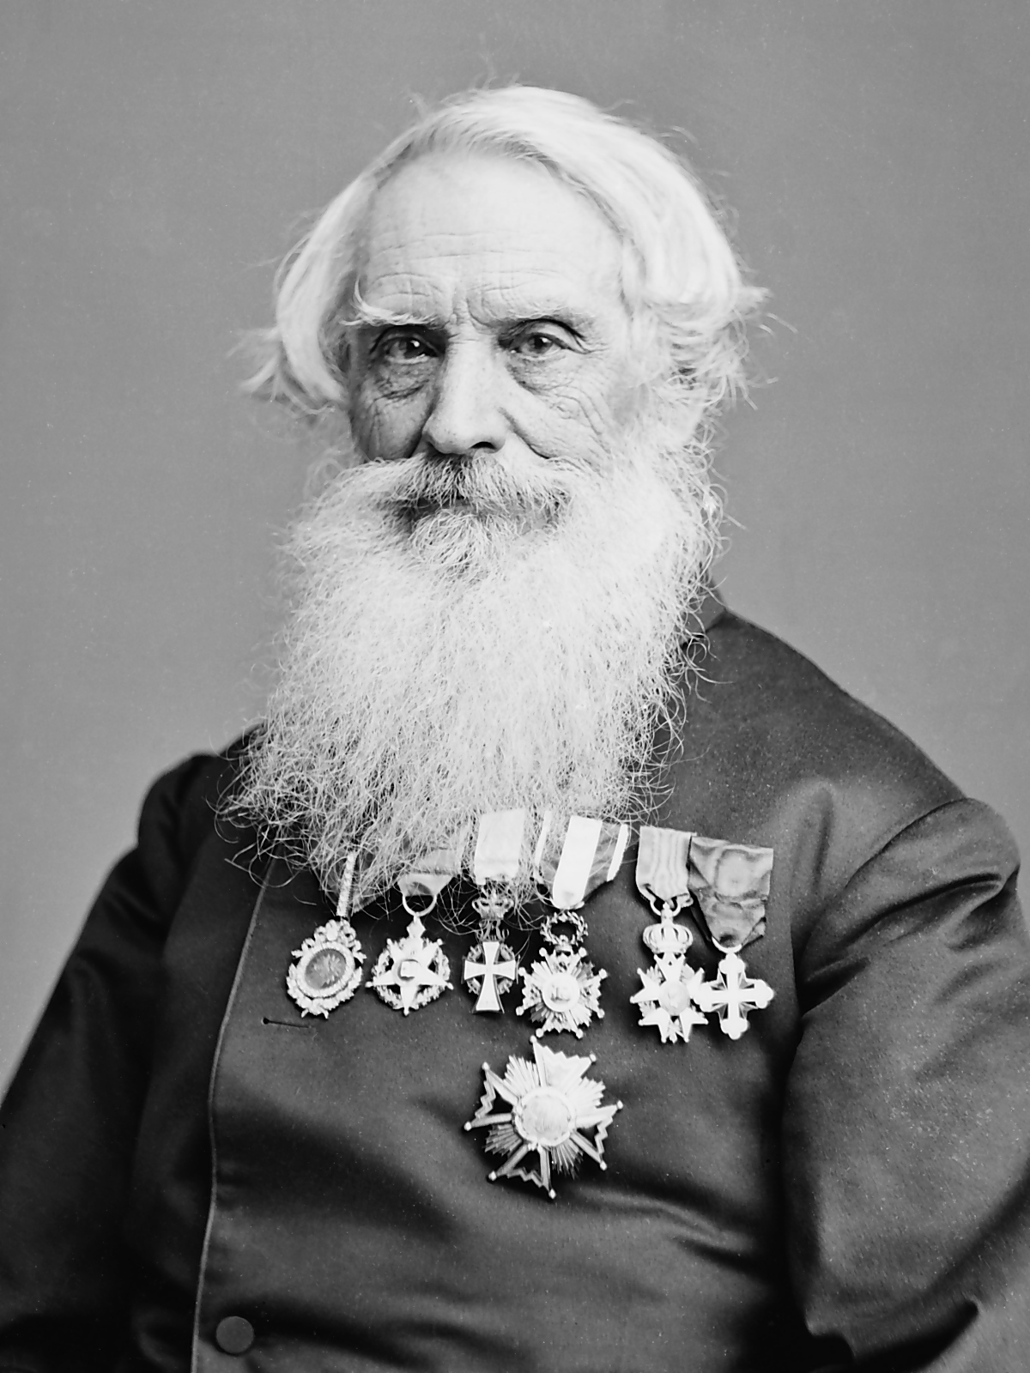
Samuel F. B. Morse
Samuel Finley
Breese Morse
(and others):
Telegraph
Morse Code

Slide 8
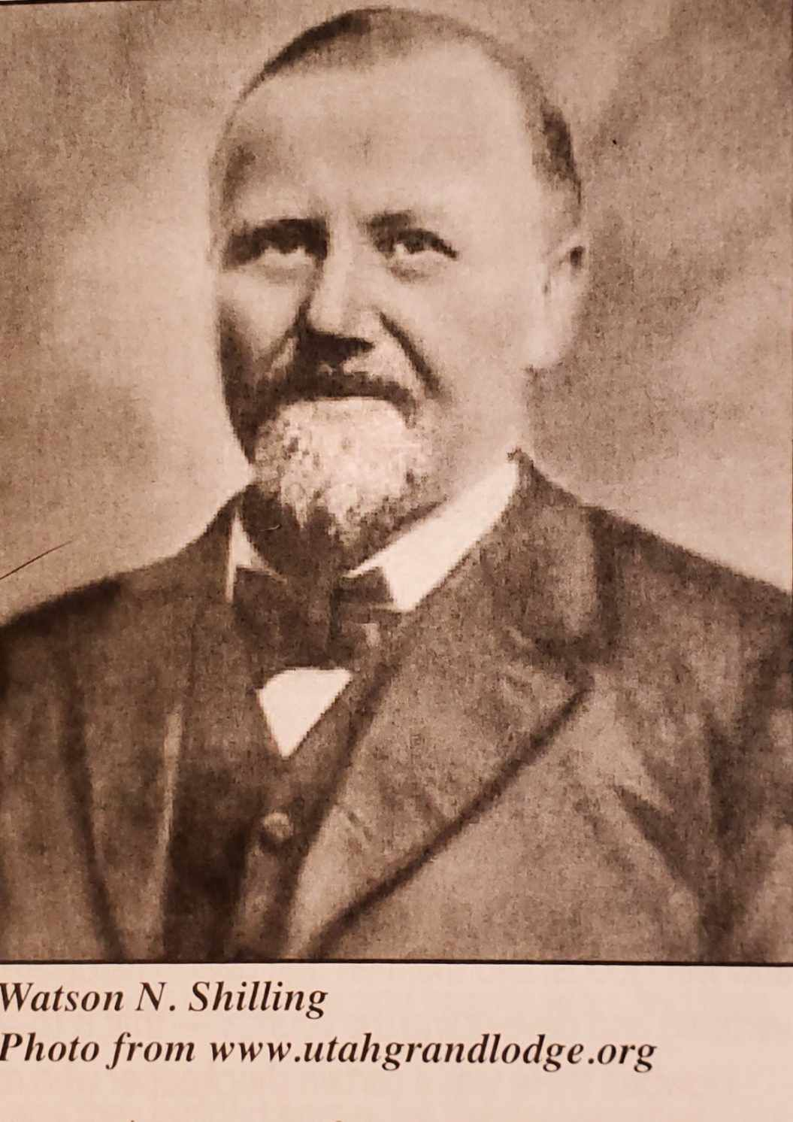
Watson N. Shilling
Watson Newton
Shilling:
Telegrapher for the
driving of the
Golden Spike
on May 10, 1869
at Promontory
Point, Utah

Slide 9
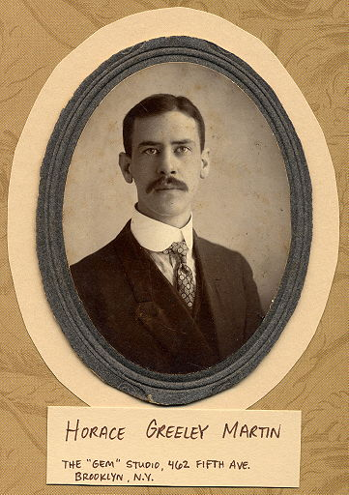
Horace G. Martin
Horace Greeley
Martin:
Semiautomatic
Mechanical
Key (Bug)

Slide 10
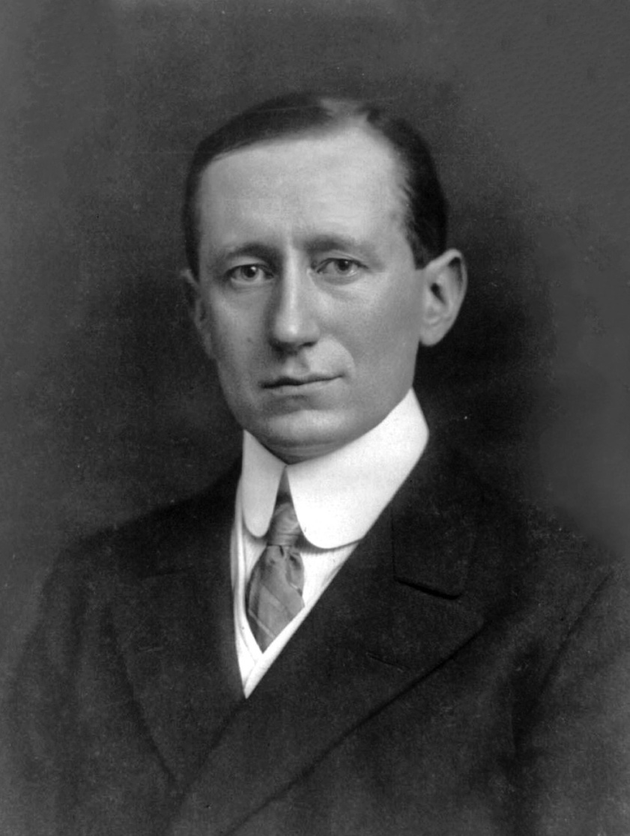
Guglielmo Marconi
Guglielmo Marconi
(and others):
Radio (Wireless)

Slide 11
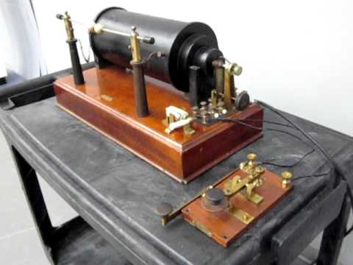
Spark Gap Transmitter
Cannibalize some Ford Model T parts and add a
bunch of fencing wire and you can build a
spark gap
transmitter—
Morse Code
only!

Slide 12
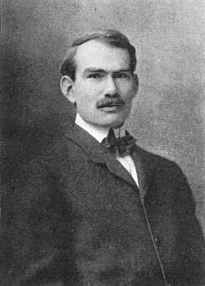
Lee de Forest
Lee de Forest
(and others):
Fire Bottles
(vacuum tubes)

Slide 13
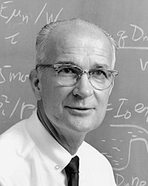
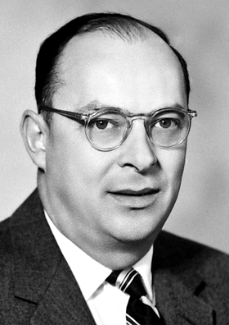
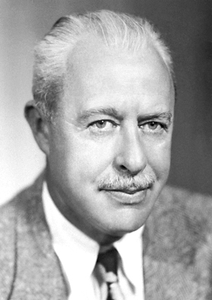
Shockley, Bardeen and Brattain
William Shockley-John Bardeen-Walter Brattain
Transistor

Slide 14
What Does It Take?
There are some amateur radio operators, who think that all it takes to be a CW operator is to buy a Morse code key.
Anyone, who believes that owning a Morse code key automatically makes one a CW operator, would believe that dropping a Baofeng HT into a baby’s crib is all that is needed to recruit a net control operator for the next two – meter net.

Slide 15
You’ll Need to Learn the Code!
To communicate with other stations, an operator will need to be able to receive and transmit the Morse code effectively.
Some people even think it’s like learning a new language.

Slide 16
Which Morse Code?
There are several versions of Morse code:
Amateur radio operators use the International Morse Code.
Don’t confuse the International Morse Code with the American Morse Code, which was historically used by the railroads.

Slide 17
Ditch the Dots and Dashes
If one intends to become proficient at communicating with the International Morse Code, one must not think in terms of “dots” and “dashes” or visual images of them.
One needs to deal only with “dits” (dots) and “dahs” (dashes) and the audio images of them.

Slide 18
Timing Is Everything!
A “dit” should be one time unit in length.
A “dah” should be three time units in length.
The spacing between “dits” and “dahs” within a character should be one time unit long.
The spacing between characters should be three time units long.
The spacing between words should be seven time units long.

Slide 19
Strive For a Good Fist
There are a lot of bad CW operators out there.
Following the rules for timing will help to
avoid becoming one of them.
Practice receiving code with good timing. It will be less frustrating.

Slide 20
Practice Resources:
Old School, but still viable:
Recordings: Records, tapes, DVD’s, etc.
Mechanical / Electronic Devices: Instructograph, etc.
More Up To Date:
Internet Sources
Apps
On The Air Operating
ARRL Code Practice (if you can receive it)
A Buddy or Elmer

Slide 21
Start With Accuracy, and Later Develop Speed
Code copied inaccurately has no value. Always strive for accuracy.
After accuracy is mastered, work toward speed.
Concentrate on learning to copy well first. Learning to send can come later.

Slide 22
Avoid Plateaus
Plateaus in learning to copy code sometimes occur roughly every three words per minute. Their effects can be avoided or minimized by:
Learn the code by listening—not visually.
Use multiple short intensive practice sessions instead of single long sessions.
Lagging behind a character or two may help.
Use the Farnsworth Method.
PRACTICE, PRACTICE and PRACTICE.

Slide 23
Farnsworth Method
Characters are sent at the target speed.
Sufficient spacing is inserted between the characters so that the code is received at a slightly higher speed than can be comfortably copied.

Slide 24
Code Competency Was Once Part of the Tests for Licenses
Novice – 5 words per minute
Technician – 5 words per minute
General / Conditional – 13 words per minute
Advanced – 13 words per minute
Amateur Extra – 20 words per minute

Slide 25
Respect for CW
I hold an Amateur Extra Class License however, I received it after the FCC dropped the code test requirement. For this reason, I am not a 20 word per minute Extra. I am a 13 Word Per Minute Advanced.
I have all of the respect in the world for anyone, who is a 20 Word Per Minute Extra.

Slide 26
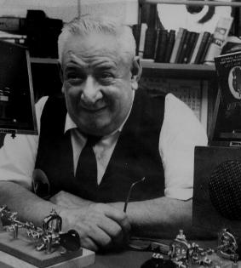
The Code Copying Record
Ted Roosevelt McElroy,
W1JYN (SK)
demonstrated his ability
to copy code at 77 words
per minute in 1935.

Slide 27
Sending the Code
Worry about copying the code first. Sending comes easier afterwards.

Slide 28
Straight Key

Slide 29
Buying a Straight Key
A straight key is actually nothing more than a SPST switch.
Your happiness and comfort over the long term may well be determined by the straight key you use, so buy a good one.
Avoid cheap and poor quality straight keys—they won’t hold up over the long term.

Slide 30
A Good Straight Key
Military straight keys are generally very good, if you can find them. They are becoming very hard to find.
Make sure the gap and the tension can be adjusted. Adjustment of the resistance may also be helpful.
The key should have a base that keeps the key from sliding around.

Slide 31
Bug

Slide 32
Bug (continued)
Extended code operation with a straight key can be very tiring for the hand and the wrist.
Bugs are mechanical keying devices that shift the vertical hand motion to a more comfortable sideways motion.
“Dahs” are sent individually like on a straight key.

Slide 33
Bug (continued)
A spring allows multiple “dits” to be sent with single motions.
Practice with a well – adjusted bug can save a great deal of fatigue in the hand and wrist.
Bugs tend to be pretty expensive.
Viproplex makes good quality bugs.

Slide 34
Keyers
Keyers work sideways like a bug instead of vertically like a straight key.
Unlike bugs, keyers are often fairly inexpensive because the mechanical workings are replaced by electronics.
Keyers require a set of paddles, which may be built – in or attached as an outboard accessory.

Slide 35
Keyers (continued)
Multiple “dits” and “dahs” can be sent with a single motion on keyers.
Some keyers have iambic capabilities, which allow one to send “dits” and “dahs” alternately.
Some keyers have memory provisions, that allow the operator to store often used code sequences like “CQ’s”, call signs, exchanges, etc.

Slide 36
Computers for CW
Some computer software makes it possible to send and receive code with the computer.
This makes sense, since some people consider CW to be the original digital mode.
Talk to an experienced ham for computer / software recommendations.

Slide 37
RST System
Readability – Scale of 1 to 5
Strength – Scale of 1 to 9
Tone – Scale of 1 to 9
Example:
“RST is 599” would be a very good signal report.
This may be reported as “5NN”.

Slide 38
Q Signals / Q Codes
Q signals save a lot of time and effort.
Q signals are universally understood everywhere. They break the language barrier.
Q signals ending in a “?” are questions.
Q signals not ending in a “?” are statements or responses to questions.
“QLF”, which means “I am sending with my left foot.”, is pretty much tongue in cheek.

Slide 39
Prosigns
Like Q signals, prosigns save a lot of time and effort.
Like Q signals, prosigns are universally understood. They break the language barrier.

Slide 40
Getting Started
Go to the traditional Novice portions of these bands:
80 meters: 3.525 – 3.600 MHz.
40 meters: 7.025 – 7.125 MHz.
15 meters: 21.025 – 21.200 MHz.
10 meters: 28.000 – 28.300 MHz.

Slide 41
Getting Started (continued)
Use “QRS” to slow the other operator down, if necessary.
If you want the other operator to send slowly, you should understand that you need to send at the same speed as well.

Slide 42
Me Too
OM = Old Man
OM works for all males regardless of age or marital status. It won’t get anyone in trouble.
YL = Young Lady (a younger woman)
XYL = Ex Young Lady (an older woman)
YL or XYL can cause serious problems if used incorrectly.

Slide 43
Me Too (continued)
73 = Best Regards
73 is an all – around good way to say good – bye. Use it!
88 = Love and Kisses
Don’t use 88! It can get you into big trouble.

Slide 44
Important
ACCURACY
is always
MORE IMPORTANT
than
SPEED.

Slide 45
USS Paddle (SS – 263)

Slide 46
USS Paddle (continued)
U.S. submarine commanded by Lt. Commander Byron Nowell of Salt Lake City, Utah (United States Naval Academy - Class of 1935)
Patrolled off the west coast of Mindanao, Phillippines during World War 2
Searched for opportunities to engage with Japanese naval forces

Slide 47
Radio Messages
On September 7, 1944, the USS Paddle received the following radio message:
“SHINYOO MARU 750 troops for Manila via Cebu”
“SHINYOO MARU 750 Ps/W for Manila via Cebu”

Slide 48
Shinyo Maru

Slide 49
Shinyo Maru (continued)
One of many Japanese “Hell Ships”
Originally a British freighter ship captured by the Japanese in Shanghai and renamed
Loaded with 750 U.S., Dutch and British prisoners of war
No markings on ship indicated what cargo it was carrying

Slide 50
The Massacre
Two torpedoes
Grenades thrown into the hold
Automatic small arms on deck
Armed patrol boats in convoy

Slide 51
The Survivors
83 of the 750 P.O.W.’s aboard the Shinyo Maru managed to evade torpedos, grenades and gunfire and swim to shore:
Private John J. McGee passed away the next day.
First Sergeant Joseph P. Coe, Jr. remained behind and joined the guerilla forces to fight the Japanese.
81 rescued by the USS Narwhal (SS – 167) on October 29, 1944.

Slide 52
The Lost
Of the 750 P.O.W.s on the Shinyo Maru, 668 did not survive.
That means 89.1% did not survive.
Only 10.9% made it back home.

Slide 53
Re - Emphasis
ACCURACY
is always
MORE IMPORTANT
than
SPEED!

Slide 54
The Rest of the Story
Private Frederick David (Fred) Thomas
Malad City / St. John, Idaho & Dayton, Idaho
December 29, 1918 – September 7, 1944
Brother of Fred:
Boyd Thomas (SK)
(W7AVY * WB7SPX * KG7MP)
Malad City, Idaho

Slide 55
The Legacy
Boyd Thomas (SK)
(W7AVY * KG7SPX * KG7MP)
May 22, 1923 – December 22, 2008
Malad City, Idaho
Richard David (Dick) Thomas
(WN7VKE * WA7VKE * WA7VKE/C6A)
Malad City, Idaho – Moreland, Idaho

Slide 56
The End
Questions?
Comments?
Witty Sayings?

